Slide 1
Start-ups
By 2/c Matt Varney and 2/c Will Sergio

Slide 2
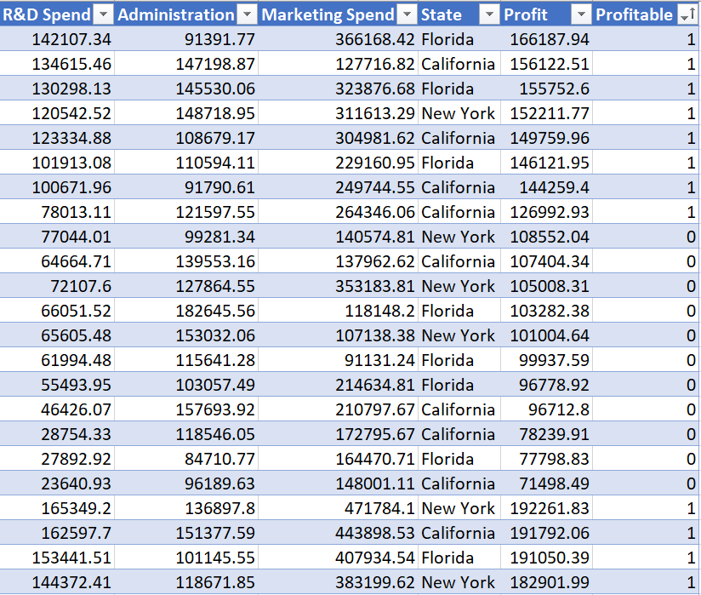
Overview of data

Slide 3
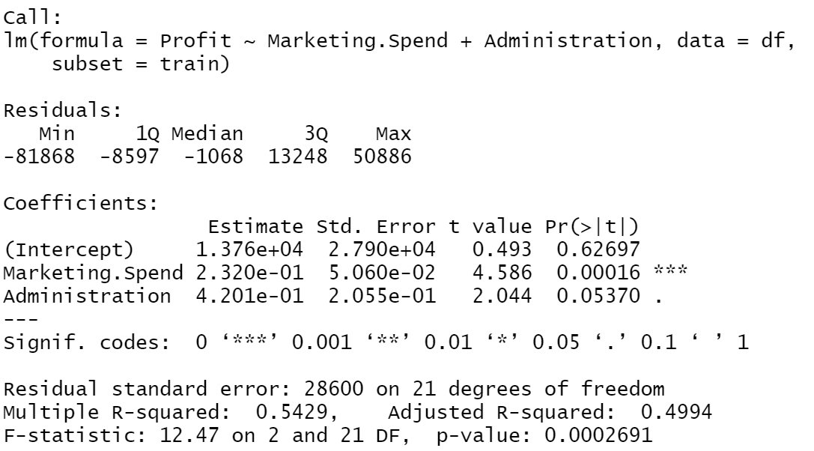


Review of previous model’s success

Slide 4
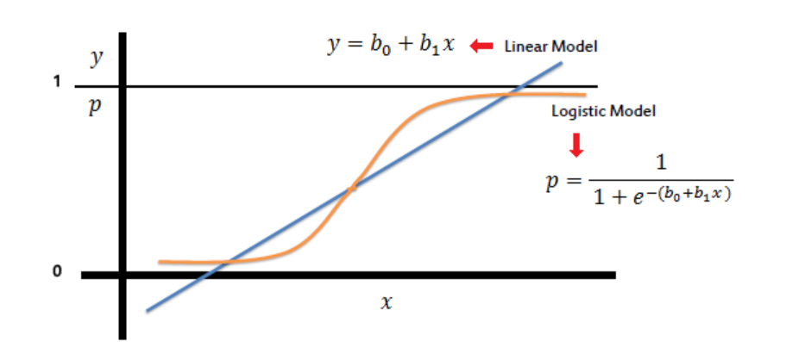
Logistic Regression vs. Linear regression

Slide 5
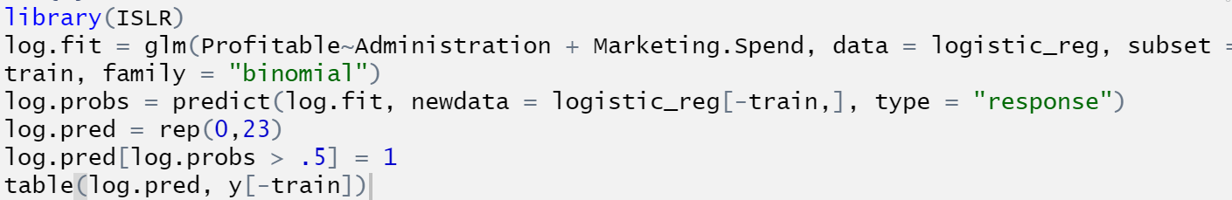

First trial

Slide 6
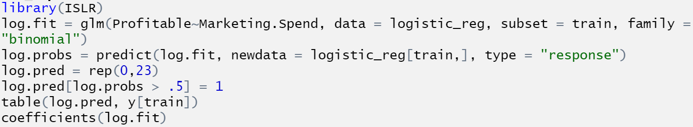
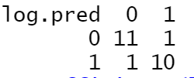
Secondish Trial

Slide 7



Summary

